Slide 1
What is a Computer?

Slide 2
CPU
Central Processing Unit
Interprets a sequence of instructions of a computer program
Performs arithmetic calculations on data based on program instructions
Instructions are executed in sequence unless instructions indicate a jump forwards/backwards
The clock speed controls how quickly those instructions can be executed
The higher the speed, the more instructions per second the CPU can execute
Read necessary data from RAM
Write resultant data to RAM
Keep frequently used data in the cache

Slide 3
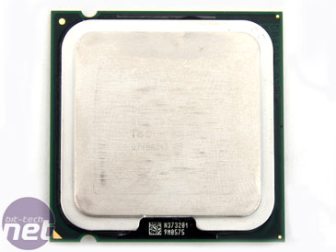
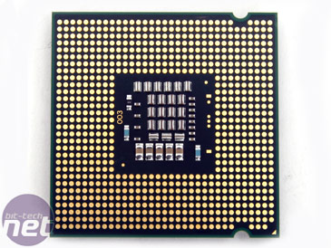
Example: Intel Core i5-4670
Uses the x86-64 instruction set
The x86-64 instruction set has between 200-250 individual instructions.
Each instruction is 64 bits (8 Bytes) in size
Has a clock speed of 3.4 GHz
Has a 6MB Cache – internal memory the CPU uses for data it thinks it will frequently access and manipulate
Has 4 cores which means that there are in fact 4 processors working together to act as one super-processor

Slide 4
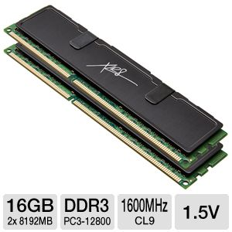
RAM
Random Access Memory or Main Memory
Place to store currently running programs
Place to store data currently being used by the CPU

Slide 5
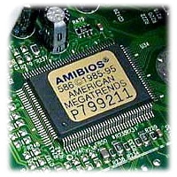
BIOS
Basic Input/Output System
Set of specific instructions to do the following:
Identify all connected hardware components and ensure their proper working operations
Ensure every spot in RAM is functioning properly
Locate the Operating System on secondary storage, copy it to RAM, and start the OS
Modern BIOSes are configurable and allow you to tweak system performance including:
Prioritizing which secondary storage locations to search for the OS
Adjusting the clock speed (can increase the speed to higher-than-recommended settings provided your CPU will not corrupt instructions and the cooling system will prevent the CPU from overheating and melting)

Slide 6
Motherboard
Main circuit board that all components are connected to
Motherboards contain a collection of buses – a dedicated connection between one component and the motherboard
There are many kinds of buses and various components will use a specific type of bus
Some buses are very fast (and large) such as the bus for RAM and the bus for the Video Card
Other buses are slow such as the one for the hard drive or the mouse/keyboard

Slide 7
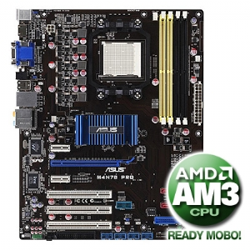
Example: Asus P6T
Processor type: AMD
4 DIMM slots for RAM
3 PCI slots for various cards
1 PCI-Express slot for the Video Card
2 PCI-Express slots for various cards
2 SATA ports for Hard Drive/DVD-ROM/other
4 USB ports for peripherals

Slide 8
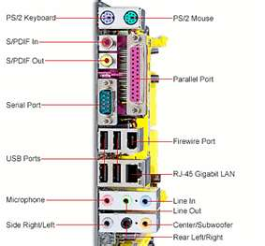

Slide 9
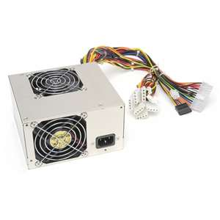
Power Supply
Converts AC power from the wall to lower power requirements for each necessary component.
Most internal components require a dedicated supply of power from the power supply
The more Watts power supply gives, the more devices/drives your computer can support
E.g. 400W Power Supply

Slide 10
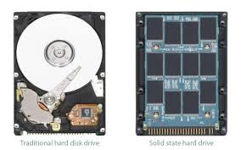
Hard Drive
Main permanent storage of a computer
Data to be used is copied from the hard drive into RAM
Data to be saved is copied from RAM to the hard drive
Hard drives come in two basic types:
Magnetic disc drives store data on magnetic discs. More information can be stored at the expense of slower data read/writes
Solid state drives use flash memory for very fast data read/writes, but capacity is relatively small and is much more expensive

Slide 11
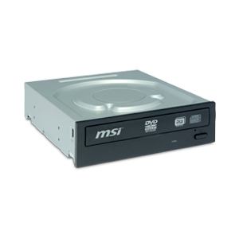
ROM
Read Only Memory
Memory that cannot be changed
Examples are:
Commercial CDs and DVDs
Finalized burned CDs and DVDs
Files available for download from the Internet

Slide 12
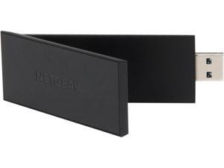
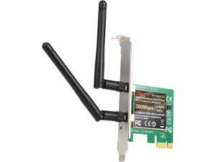
Network Adapter
Dedicated component to allow your computer to connect to a wireless computer network
Most motherboards support direct Ethernet connections via Ethernet cable
Wireless adapters may be internal or external components

Slide 13
Graphics Card
Dedicated component to convert video data to signals that can be viewed on a screen
Often a portion of RAM is dedicated for graphical data only and can be directly accessed by the graphics card
Modern graphics cards are in fact mini computers. They contain:
A dedicated GPU (graphics processing unit) to perform all the calculations related to graphical display
Internal VRAM (Video RAM) to manipulate graphical data copied from RAM
A built-in cooling system of fans and heat sinks to keep the GPU from overheating

Slide 14
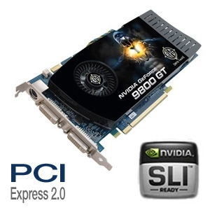
Example: NVidea 9800 GT
GPU: GeForce 9800 GT
VRAM: 512 MB
Clock speed: 600 MHz
Interface: PCI Express 2.0 x16
Ports: 2 x DVI (supports two monitors at once)
S-Video Out

Slide 15
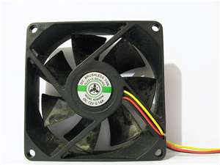
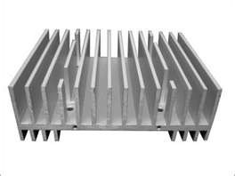
Fans & Heat Sinks
Fans and Heat Sinks are installed over the CPU to prevent it from overheating and shorting out.
Additional fans may be installed in the computer case to further cool the CPU and components.

Slide 16
Peripherals
A peripheral is a component connected to the computer but outside the computer casing.
Often, we classify devices as an input device, an output device, or both
Examples:
Monitor (AKA Standard Output)
Take data from the video card and display it to the user
Keyboard (AKA Standard Input)
Convert keystrokes to data and send the data to the CPU
Mouse (Input Device)
Convert mouse movements and mouse clicks to data and sent the data to the CPU

Slide 17
Peripherals
More Examples:
Printer (Output Device)
Convert data on the screen to text/images on paper
Scanner (Input Device)
Convert text/images on paper to data on the screen
Flash Stick (Both)
Portable memory that can be connected via a USB port
Speakers (Output Device)
Convert data from the sound card or motherboard to meaningful sound/music
Microphone (Input Device)
Convert voice/music/sounds into signals that can be interpreted by the sound card for data storage
Webcam (input device)
Converts light to a data format that can be reproduced on a monitor

